Slide 1
Flight Delay Prediction J Vinay POLANKI M00355995
CIS 663 Developing Analytical Applications

Slide 2
Outline Of Project
Motivation For Project
Data
Research Question
Challenges
Limitations
Results
Future Work

Slide 3
Motivation Of the Project:
Indian Rail Tracking Application is the Idea behind the Project.
Helps Airlines to increase Operational performance.
Airlines Manages Operations and resources effectively
Passengers can manage their travel based on the flight delay.
provides better customer service and avoids Inconvenience

Slide 4
DATA:
DATA Collected from Bureau Of Transportation Statistics which provides the Historical Flight DATA.
Data is collection Historical Flight Data like Airport, Carrier, Different type of Delays and Delay in minutes, Number of Arrival Flights and different reasons like carrier delayed flights arrival delayed Flights.

Slide 5
Research Question:
H1: Significance of Different type of Delays on the dependent Variable(Delay_120)
Through this Project I would like address the Delay of Flights based on different reasons. Where delay is greater than 120 minutes(2 hours).
This Predictive Model helps both Airlines and Passengers to organize their journey; Airlines can effectively manage and Improve their operations
After understanding the DATA, multiple independent variable and Dependent Variables.
I opted for Logistic Regression and Decision Tree for the prediction and to create a Model.

Slide 6
Challenges:
Understanding the DATA and Structure of it.
Finding significant variables for predicting dependent.
Data distribution in EDA analysis.
Determining and Choosing regression model for prediction.

Slide 7
Limitations Of the Project:
Excluded almost half of the rows while Filtering.
Haven’t considered other aspects or delays like ground operations.
Considered DATA only for one month in a year.
More generalized as it is collected for Different Airlines and different Airports.

Slide 8
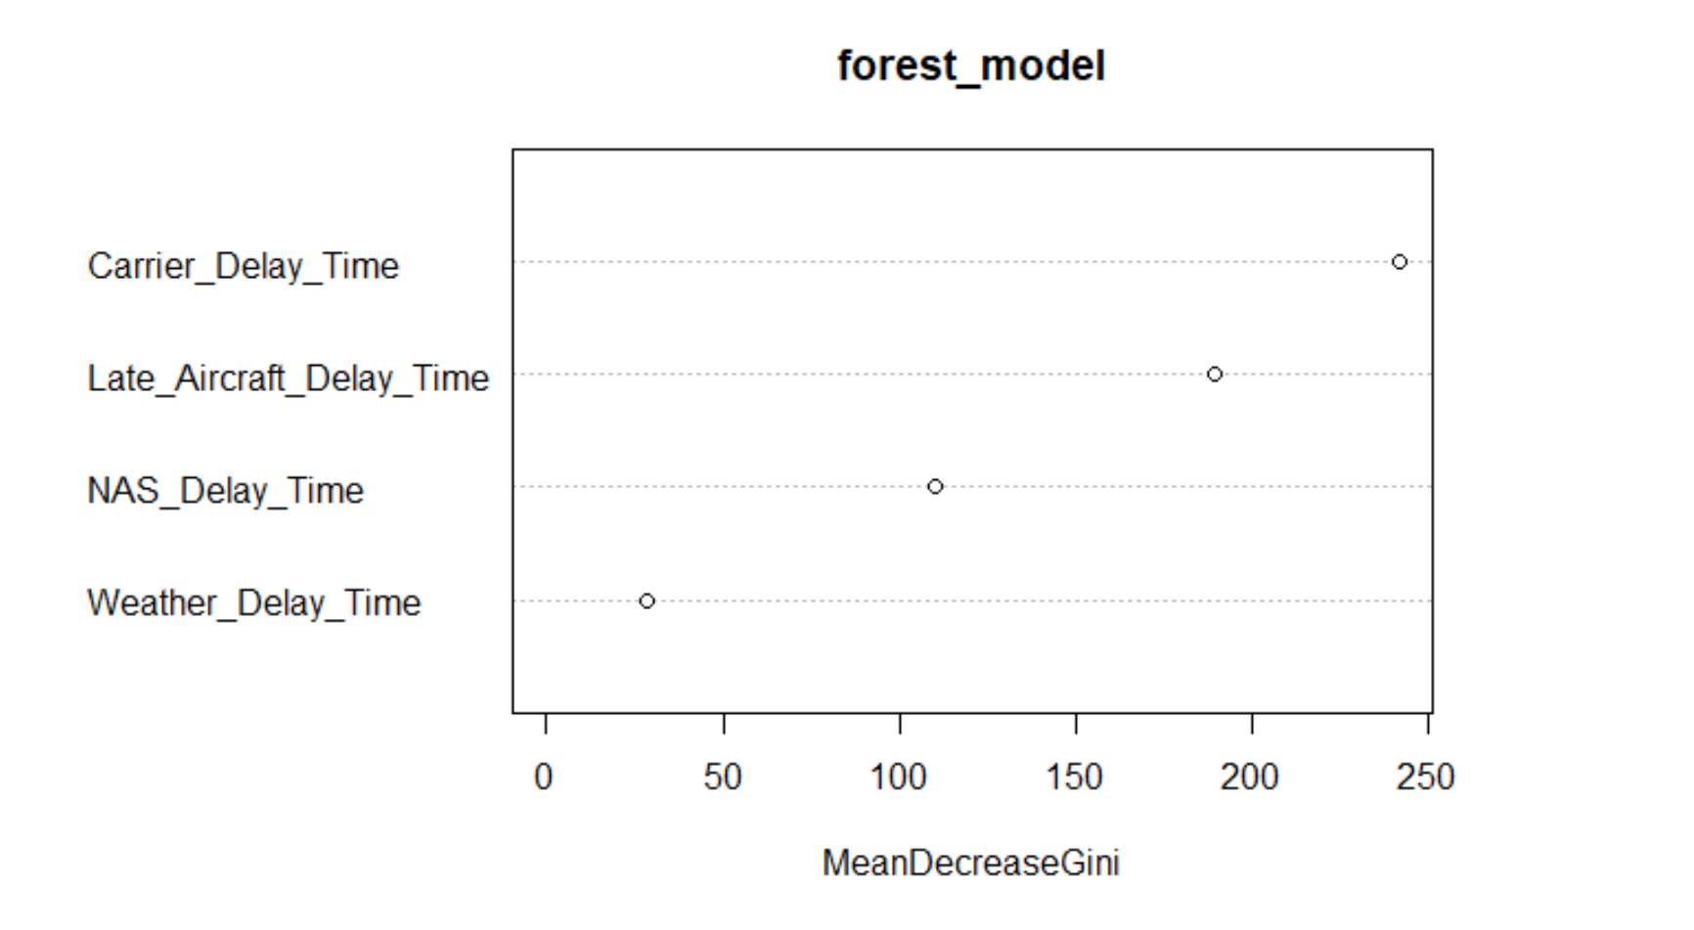

Slide 9
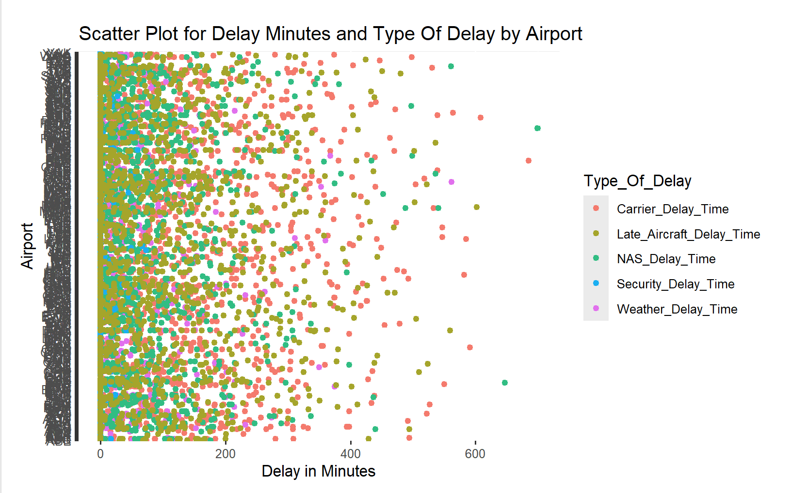
Results:
EDA Analysis:
Security Delay is Mostly Distributed close to zero.
Whereas other delays are distributed near zero with significant observations away from zero.

Slide 10
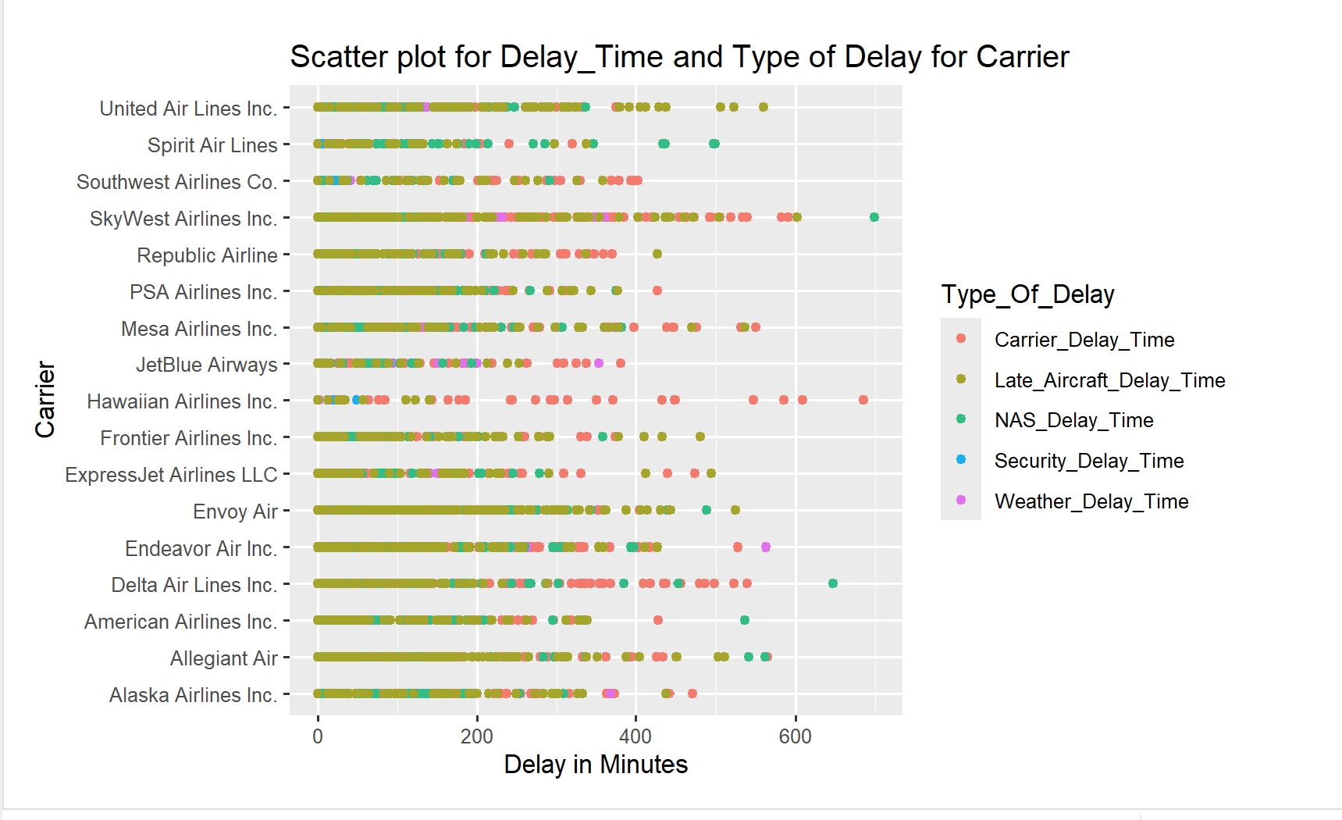
Results:

Slide 11
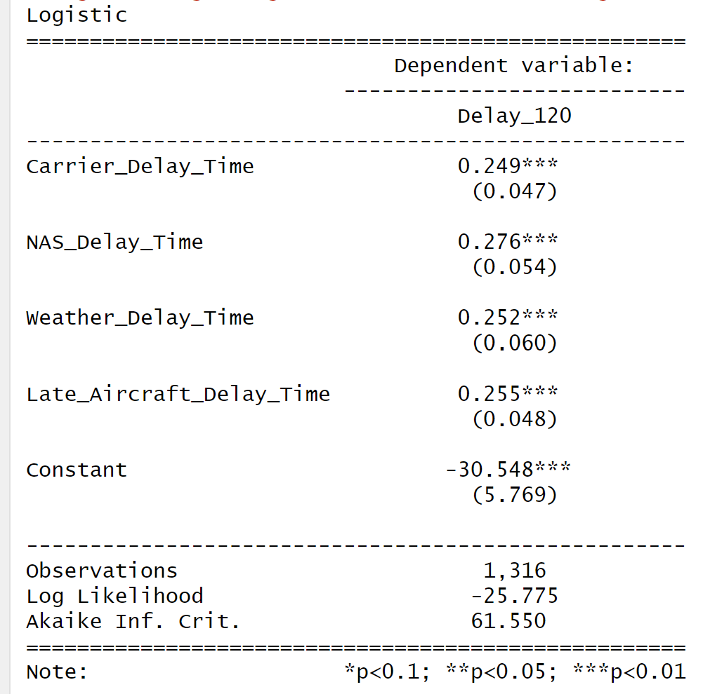
Interpretation Of Results:
SE: due to Multicollinearity and Variability of the DATA.
Constant: Base line when Predictors set to 0.
Co-efficient: change in log odds/each unit change (Binary).
AIC: shows the best model to select when comparing two or more Models.

Slide 12
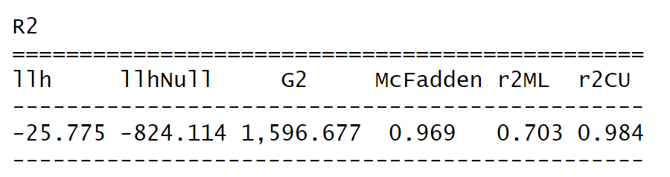
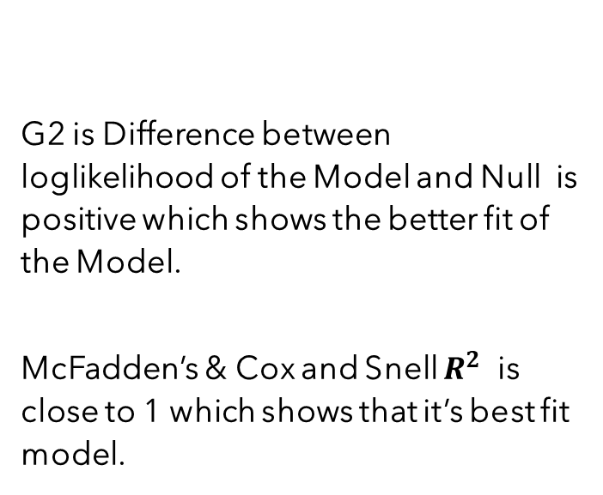
Interpretation Of Results:
G2 is Difference between loglikelihood of the Model and Null is positive which shows the better fit of the Model.
McFadden’s & Cox and Snell $R^{2}$ is close to 1 which shows that it’s best fit model.

Slide 13
Future_Work:
I would like to work further on this project by collecting the Data for the single airport with different carriers and considering other delays such as operational delays which include Ground operations delay, carrier check in delays.
Working on the single Airport rather than collecting a wide will allow an Airport Management to Organize and work on their operations will improve the Operational Performance of that Airport.
Same can be performed for each Carrier considering the limitations of the Airport and Federal and International Aviation Regulations. Can Perform Same with each Individual Airlines.

Slide 14
References:
Loura, J. (2014). Human factors and workload in air traffic control operations-a review of literature. International Journal of Management and Social Sciences Research, 3(3), 1-5. Hilburn, B. (2004).
Cognitive complexity in air traffic control: A literature review. EEC note, 4(04), 1-80.Rebollo, J. J., & Balakrishnan, H. (2014). Characterization and prediction of air traffic delays.
Transportation research part C: Emerging technologies, 44, 231-241.Pamplona, D. A., & Pinto Alves, C. J. (2019). Mitigating Air Delay: An analysis of the Collaborative Trajectory Options Program.
Engineering, Technology & Applied Science Research, 9(3).Xing, J., & Manning, C. A. (2005).
Complexity and automation display of air traffic control: Literature review and analysis.Kontogiannis, T., & Malakis, S. (2009).
A proactive approach to human error detection and identification in aviation and air traffic control. Safety Science, 47(5), 693-706.Osetrov, E. (2023, October 10).
Airline delays. Kaggle. <https://www.kaggle.com/datasets/eugeniyosetrov/airline-delays?resource=download>.
Controller workload (Arad, 1964; Grossberg, 1989; Redding, 1992; Athènes, S., Chaboud et al., 2000) A-Z index. A-Z Index \
Bureau of Transportation Statistics. (n.d.). <https://www.bts.gov/A-Z-Index> Team, T. H. (n.d.).
The Epidemiologist R Handbook. 42 Dashboards with R Markdown. <https://epirhandbook.com/en/dashboards-with-r-markdown.html>

Slide 15

Thanks

